Slide 1
SPECIAL OSCILLOSCOPES

Slide 2
Introduction
Broadly speaking, oscilloscopes are mainly of two types: analog and digital. An analog oscilloscope works by applying the measured signal voltage directly to an electron beam moving across the oscilloscope screen.
We have already discussed the analog oscilloscope in the previous chapter. The fastest analog scopes can display frequencies up to about 1 GHz. Analog oscilloscopes are preferred when it is important to display rapidly varying signals in real time.
The digital oscilloscope uses fast analog-to-digital converters to convert the voltage being measured into digital form and digital signal processors for signals processing.

Slide 3
Types of Oscilloscope
The oscilloscope may also be classified more conveniently as listed below:
1. Delayed Time Base Oscilloscope
2. Dual Beam Oscilloscope
3. Dual Trace Oscilloscope
4. Digital Storage Oscilloscope
5. Sampling Oscilloscope
6. Digital Phosphor Oscilloscope
7. Digital Readout Oscilloscope
8. High Frequency Oscilloscope
All these types of oscilloscopes are discussed one by one in the following pages.

Slide 4
Delayed Time Base Oscilloscope
In this oscilloscope, the input signal of the vertical plates is delayed by some finite time with delay circuit.
The signal before the delay circuit is applied to the trigger time base circuit to the horizontal section as shown in Fig. 8.1.
This allows the study of all leading or lagging edges of a pulse type waveform.

Slide 6
The triggering of time base input signal sweep starts in time. In vertical section the sweep is triggered and delayed waveform is displayed as shown in Fig. 8.2.
The delayed time base oscilloscope uses two time base generators. One is normal time base while the other one is an additional time base generator.
The additional time base generator is superimposed on the additional time base generator output.
Due to this additional time base the waveform can be brightened when oscilloscope is running on a normal time base.
The block diagram of delayed time base oscilloscope is shown in Fig. 8.3.
As seen in the figure, it uses main time base and delayed time base circuit.

Slide 9
STORAGE OSCILLOSCOPE
There are two types of storage oscilloscopes, namely,
1. Analog storage oscilloscope
2. Digital storage oscilloscope

Slide 10
1. Analog storage oscilloscope
An analog storage oscilloscope uses the phenomenon of secondary electron emission to build up and store electrostatic charges on the surface of an insulated target.
Such oscilloscopes are widely used
(i) for real-time observation of events that occur only once, and
(ii) for displaying the waveform of a very low frequency (VLF) signal.
The construction of a CRT using variable persistence storage technique, called the halftone or mesh storage CRT is shown in Figure 9.20. With the variable persistence the slow swept trace can be stored on display continuously by adjusting the persistence of the CRT screen to match the sweep time.

Slide 12
2. Digital Storage Oscilloscope
There are a number of distinct disadvantages of the analog storage oscilloscope. These disadvantages are listed below:
1. There is a finite amount of time that the storage tube can preserve a stored waveform. Eventually, the waveform will be lost. The power to the storage tube must be present as long as the image is to be stored.
2. The trace of a storage tube is, generally, not as fine as a normal cathode ray tube. Thus, the stored trace is not as crisp as a conventional oscilloscope trace.
3. The writing rate of the storage tube is less than a conventional cathode ray tube, which limits the speed of the storage oscilloscope.
4. The storage cathode ray tube is considerably more expensive than a conventional tube and requires additional power supplies.
5. Only one image can be stored. If two traces are to be compared, they must be superimposed on the same screen and displayed together. A superior method if trace storage is the digital storage oscilloscope

Slide 15
What is Digital Storage Oscilloscope?
Definition: The digital storage oscilloscope is an instrument which gives the storage of a digital waveform or the digital copy of the waveform. It allows us to store the signal or the waveform in the digital format, and in the digital memory also it allows us to do the digital signal processing techniques over that signal.
It captures non repetitive signals and displays it on the screen until the device gets reset.

Slide 16
In DSO the signals are received, stored and displayed on the screen.
The maximum frequency measured on the digital signal oscilloscope depends upon two things they are:
1) sampling rate of the scope and ADC
2) the nature of the converter. DAC
The traces in DSO are bright, highly defined, and displayed within seconds.

Slide 17
Block Diagram of Digital Storage Oscilloscope
The block diagram of the digital storage oscilloscope consists of an amplifier, digitizer, memory, analyzer circuitry. Waveform reconstruction, vertical plates, horizontal plates, cathode ray tube (CRT), horizontal amplifier, time base circuitry, trigger, and clock. The block diagram of the digital storage oscilloscope is shown in the below figure.
Digital Storage Oscilloscope (DSO)
The digital storage oscilloscope just like a normal oscilloscope is a “test and measurement” equipment.
It makes use of A/D and D/A converters internally to take advantage of processing of signals in digital form. Fig. 8.10 shows the block diagram of a digital storage oscilloscope (DSO).

Slide 19
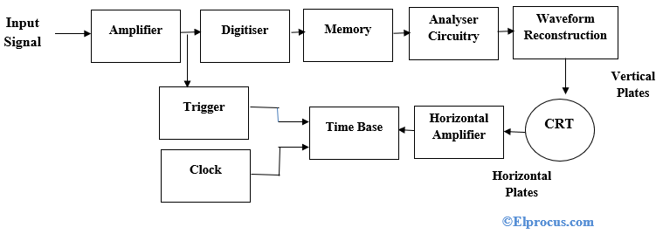

Slide 21
Figure 9.21 gives the block diagram of a digital storage oscilloscope (DSO).
It uses both of digital-to-Analog and Analog-to-Digital (DACs and ADCs) for digitising, storing and displaying analog waveforms. The overall operation is controlled and synchronised by the control circuits.
Which usually have microprocessor executing a control program stored in Read-Only Memory (ROM).
The data acquisition portion of the system contains a sample-and-hold (S/H) and a analog-to-digital converter that repetitively samples and digitized the input signal at a rate determined by the sample clock, and transmits the digitised data to memory for storage.
The control circuit makes sure that successive data points are stored in successive memory locations by continually updating the memory’s address counter.

Slide 22
When memory is full, the next data point from the ADC is stored in the first memory location writing over the old data, and so on for successive data points.
This data acquisition and the storage process continue until the control circuit receives a trigger signal from either the input waveform (internal trigger) or an external trigger source.
When the triggering occurs, the system stops acquiring data further and enters the display mode of operation, in which all or part of the memory data is repetitively displayed on the Cathode Ray Tube (CRT).

Slide 23
Digital Oscilloscope Technology
First the waveforms are conditioned by some analogue circuits then enter in the second stage which involves receiving the digital signals.
To do so, samples have to pass through analogue to digital converter and output signals get recorded in digital memory at different interval of time.
These recorded points together make a waveform. The set of points in a waveform show its length. The rate of samples defines the design of the oscilloscope.
The recorded traces are then processed by the processing circuit and obtained traces are ready to display for visual assessment.

Slide 24
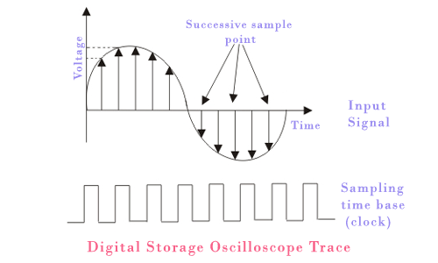

Slide 25
DSO Operation Modes
The digital storage oscilloscope works in three modes of operations they are roll mode, store mode, and hold or save mode.
Roll Mode: In roll mode, very fast varying signals are displayed on the display screen.
Store Mode: In the store mode the signals stores in memory.
Hold or Save Mode: In hold or save mode, some part of the signal will hold for some time and then they will be stored in memory.
These are the three modes of digital storage oscilloscope operation.

Slide 26
Fig. 8.11 shows TDS1000B Series digital storage oscilloscopes. This model has 100 MHz bandwidth.
It provides accurate real-time acquisition up to their full bandwidth. We can easily use USB flash drive to store screenshots and waveform data.
The data can be inserted into your personal computer for importing to desk publishing or spreadsheet programs

Slide 27
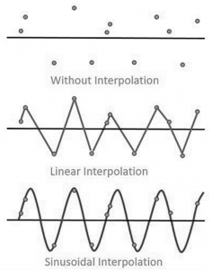
Waveform Reconstruction
There are two types of waveform reconstructions they are linear interpolation and sinusoidal interpolation.
Linear Interpolation: In linear interpolation, the dots are joined by a straight line.
Sinusoidal Interpolation: In sinusoidal interpolation, the dots are joined by a sine wave.
Waveform Reconstruction of Digital Storage Oscilloscope

Slide 28
Advantages
The digital storage oscilloscope(DSO) has many advantages than that of normal oscilloscope.
Some of the advantages are as listed below:
1. Since the DSO uses digital memory, it can store the waveforms for longer time. But in the normal CRO this cannot happen.
2. In the DSO, we can store and view the part or full waveforms before the actual trigger happens. But this is not possible in the conventional CRO.
3. In the DSO, the stored waveform can be positioned anywhere in the screen. We can actually adjust the vertical and horizontal scales of the waveform. This is not possible in the normal CRO.
4. Nowadays most of the DSOs can store as many waveforms in the memory and if needed we can take the printouts of the waveforms by connecting a normal standard printer to the DSO.

Slide 29
Disadvantages
The digital storage oscilloscope (DSO) has the following disadvantages:
1. DSOs are costly as compared to other oscilloscopes.
2. Slower compared to conventional oscilloscopes.

Slide 30
8.10 Applications of DSO
Following are some of the important applications of a DSO, which are important from the subject point of view:
1. Observation of single-pulse events: There are many phenomena which occur only once. Like occurrence of spike in any signal in a time due to some external effects, is only for the small instant of time. This can be easily recorded in the storage oscilloscope and analyzed when it required.
2. Observation of portion of waveform: The waveform recorded by storage oscilloscope is analyzed with greater detail.
3. Enlargement of waveform: Very small variation in the amplitude and frequency of the waveform is analyzed with this oscilloscope.
4. Mathematical operations: Waveform addition, subtraction, multiplication, integration, differentiation and feature comparison are possible with DSO.
5. As a measuring device: It can be used as multimeter, voltmeter, ammeter, ohmmeter, temperature meter etc

Slide 31
It checks faulty components in circuits
Used in the medical field
Used to measure capacitor, inductance, time interval between signals, frequency and time period
Used to observe transistors and diodes V-I characteristics
Used to analyze TV waveforms
Used in video and audio recording equipment’s
Used in designing
Used in the research field
For comparison purpose, it displays 3D figure or multiple waveforms
It is widely used an oscilloscope

Slide 32
8.11 Acquisition Methods
In digital storage oscilloscope it is necessary to capture the digital signal and store it. There are three different types of acquisition methods.
1. Real time sampling. In this method the response to single trigger event, a complete record of N samples, is simultaneously captured on each channel. From these samples recorded in a single acquisition cycle, the waveform is displayed on the screen of digital storage oscilloscope.
2. Random repetitive sampling. In this method repeated real time data acquisition cycles are performed. Each sample value is plotted independently on display as a dot. Interpolation between samples is not done. Each acquisition cycle produces random time interval between trigger point and sample clock.
3. Sequential repetitive sampling. In this method one sample per trigger event is captured at a carefully controlled time delay after the triggering pulses. This delay is increased by small amount after each point is captured. The single sample acquisition cycle is repeated till the entire waveform has been plotted.

Slide 33
Difference Between Digital Storage Oscilloscope and Conventional Storage Oscilloscope
The difference between DSO and the conventional storage oscilloscope or analog storage oscilloscope (ASO) is shown in the below table.

